Slide 1

Superintendent’s Proposed FY2020 Budget
Dr. Sean Bulson
January 22, 2019

Slide 2
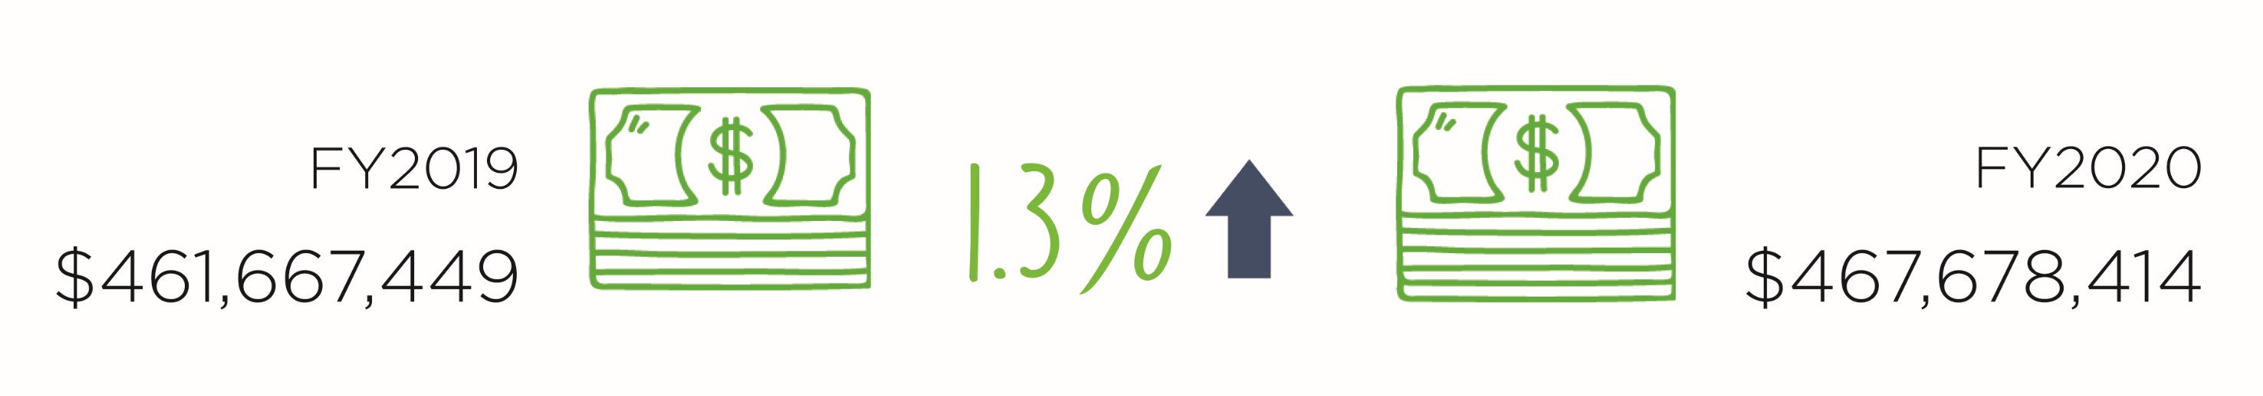

Slide 3
Total Annual Revenue Up $52 Million

Slide 4
625 Fewer Positions Since 2011

Slide 5
Cost of Salaries and Benefits Up $55 Million
Pension ↑ $8.9 Million
Insurance ↑ $35.9 Million
Salaries ↑ $11.2 Million

Slide 6
Best fit, not best practice.

Slide 7
Our Budget Gap ($ Millions)
Health Insurance Increase | 14 |  | Health Insurance Changes | (5)
Inflationary Increase | 2 |  | Reductions – Instructional Positions | (10)
Fund Balance | 11 |  | Reductions – Administrative Positions | (4.3)
Salary Package | 8 |  | Revenue from MD | (0.7)
 |  |  | Revenue from Harford County Gov. | (10)
 |  |  | Fund Balance | (5)
Shortfall | 35 |  | Balanced | (35)

Slide 8
Parameters
Began with attainable revenue target and worked backward
  84% of budget represents people
  Worked with association leadership
Stay on track with compensation and benefits at the expense of positions
  Cost containment without harming take-home pay

Slide 9
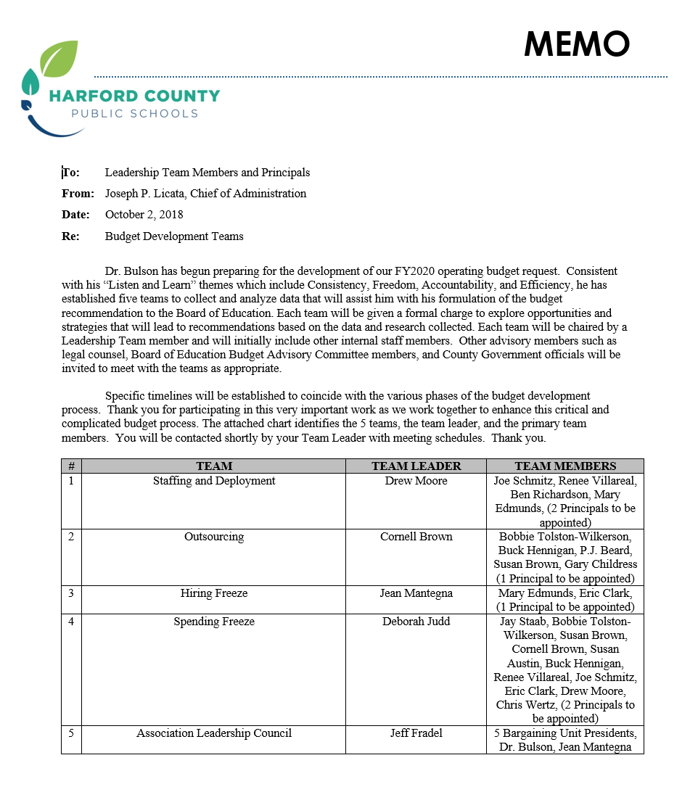
Budget Development Teams
Spending Freeze
Hiring Freeze
Staffing and Deployment
Efficiency and Outsourcing
Association Leadership Council

Slide 10
Overview
Revenue | FY 2019 | Change | FY 2020
Harford County | 245,815,645 | 10,000,000 | 255,815,645
Maryland | 201,190,128 | 652,681 | 201,842,809
Federal | 420,000 | - | 420,000
Other | 3,338,960 | 1,261,000 | 4,599,960
Fund Balance | 10,902,716 | (5,902,716) | 5,000,000
Total | $461,667,449 | $6,010,965 | $467,678,414

Slide 11
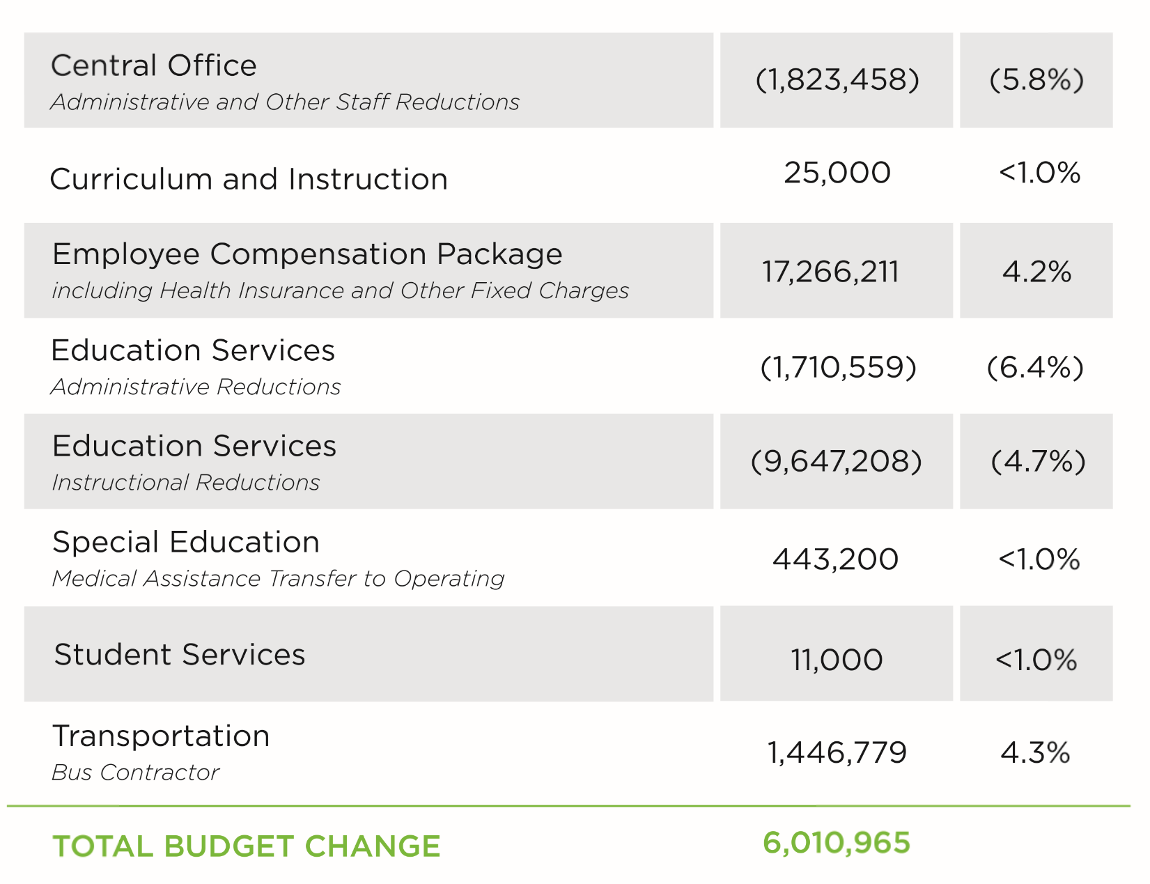
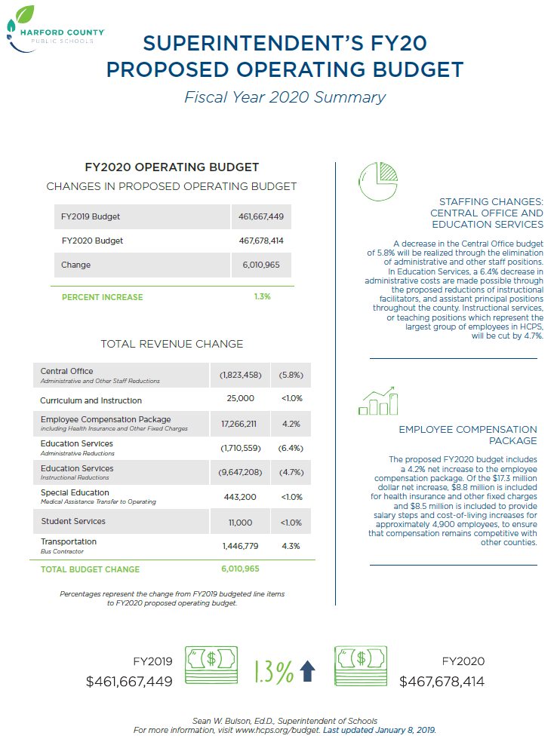
Adjustment Details

Slide 12
Budget Adjustment Details: Decreases
(3.5) | Base Budget Adjustments | --
(153.0) | Education Services-Instructional Reductions | (10,740,294)
(16.0) | Education Services-Administrative Reductions-Elementary Schools | (1,566,349)
(10.0) | Education Services-Administrative Reductions-Secondary Schools | (847,210)
(23.0) | Central Office-Administrative and Other Staff Reductions | (2,158,802)
0.0 | Health Insurance Changes | (5,000,000)
0.0 | Projected Employee Turnover | (2,000,000)
 | Total -4.8% | (22,312,655)

Slide 13
Budget Adjustment Details: Increases
0.0 | Student Services | 11,000
0.0 | Curriculum and Instruction | 25,000
6.5 | Special Education-Medical Assistance Transfer to Operating | 443,200
15.0 | Education Services-Instructional Increases | 1,093,086
3.0 | Education Services-Administrative Increases-Elementary Schools | 358,384
0.0 | Education Services-Administrative Increases-AP's 10 to 12 month | 344,616
2.0 | Education Services-Administrative Increases-Central Office | 335,344
0.0 | Transportation-Bus Contractor | 1,446,779
0.0 | Insurance and Other Fixed Charges | 15,687,951
 | Employee Salary/Wage Package Placeholder | 8,578,260
 | Total 6.1% | 28,323,620

Slide 14
Budget Adjustment Details: Totals
4,558.0 | FY 2019 Unrestricted Budget - Revised | 461,667,449
26.5 | Total increases | 28,323,620
205.5 | Less decreases | (22,312,655)
(179.0) | Total - Change FY 2019 - FY 2020 | 6,010,965
4,379.0 | FY 2020 Superintendent's Proposed Unrestricted Budget | $ 467,678,414

Slide 15
Position Reductions
3.9% of all operating budget positions (or 3.7% of all employees)
4.6% of instructional positions
11.6% of administrative positions

Slide 16

What are we working on?
Safety
  Crisis response
  Mental health
Instruction
  Reading
  Career AND College preparation
Capacity Building
  Leadership development
  Customer Service

Slide 17
Central Office Support
Students
Teachers
School Leaders
System Leadership

Slide 19
Adjustment Details (see page 5)

Slide 20
Adjustment Details (see page 21)

Slide 21
Adjustment Details (see page 21)

Slide 22
Adjustment Details (see page 21)

